Slide 1

Cătălin Hrițcu, Inria Paris

Slide 2



Our research
λ
Solving security problems
programming securely with cryptography
stopping web attacks
building secure systems
Devising formal methods
clear attacker models
program verification tools
bug finding techniques
Developing practical tools and systems
F*, miTLS, HACL*, ProVerif, CryptoVerif, ProScript, CryptoCat, QuickChick, ...
Notes:
SAY (start): My research is focused on developing rigorous formal techniques for solving security problems
SAY (end): Finally, my research has resulted in many innovative tools that I will leverage for this project.
NO: Add logos of tools? Then would have the tools for formal methods – or just keep as is
NO: find better formal methods icon: logic formulas, logical deduction rules, types / typing rules, math, a big lambda, etc

Slide 3
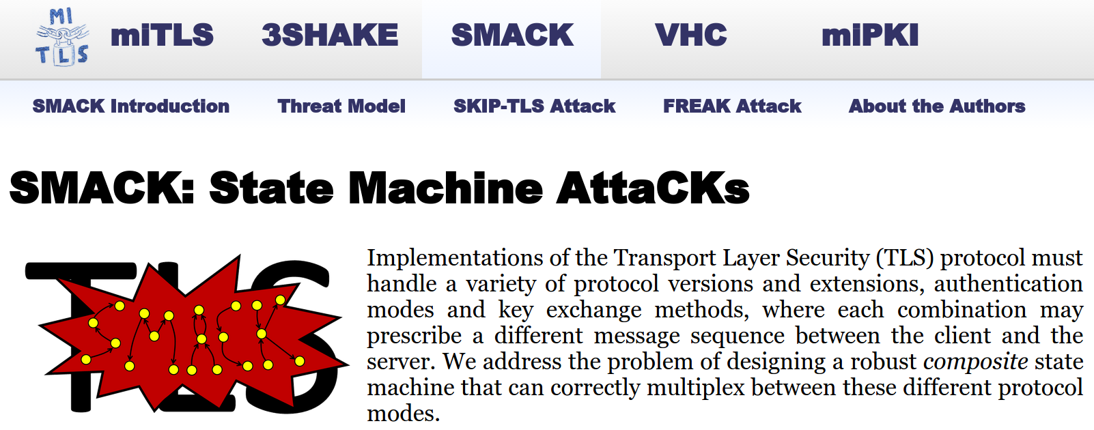
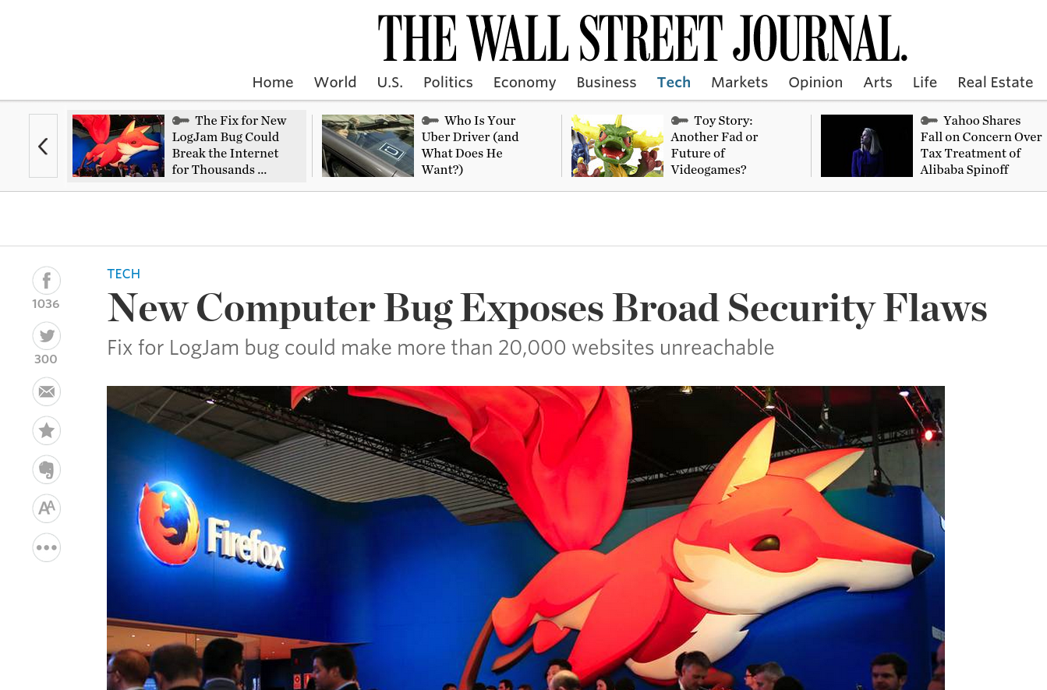
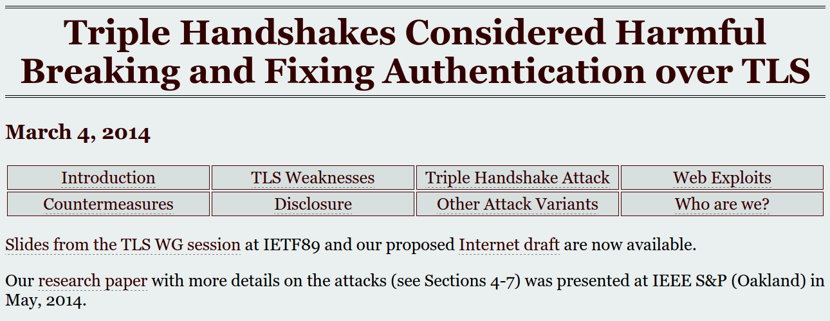
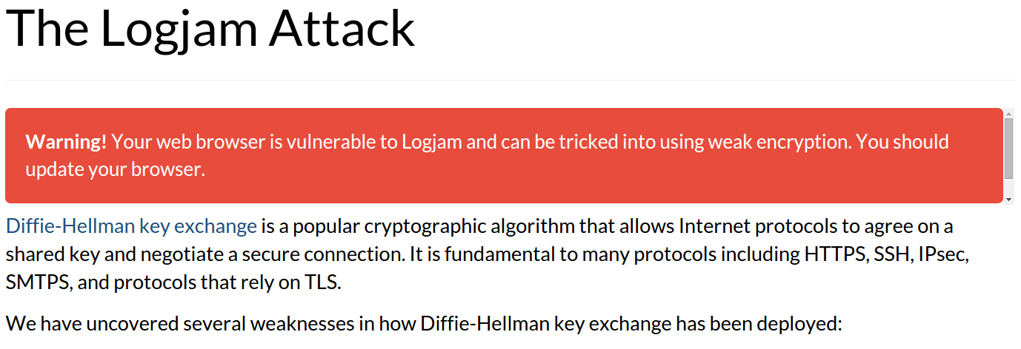
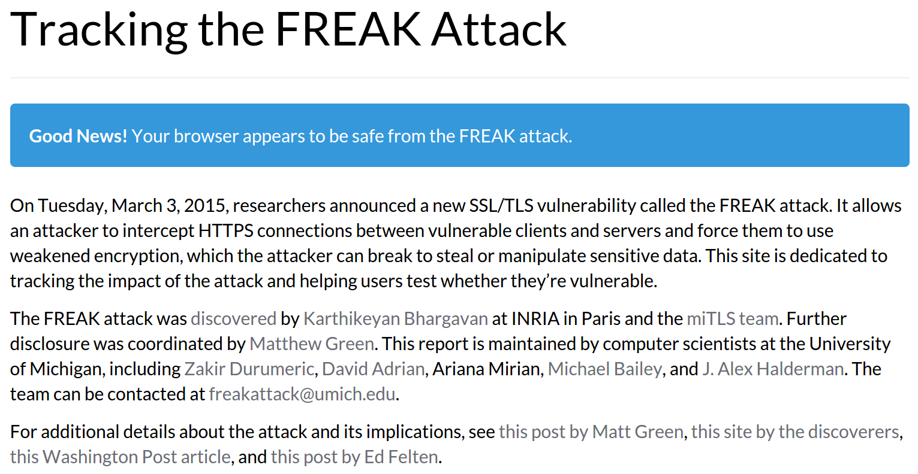
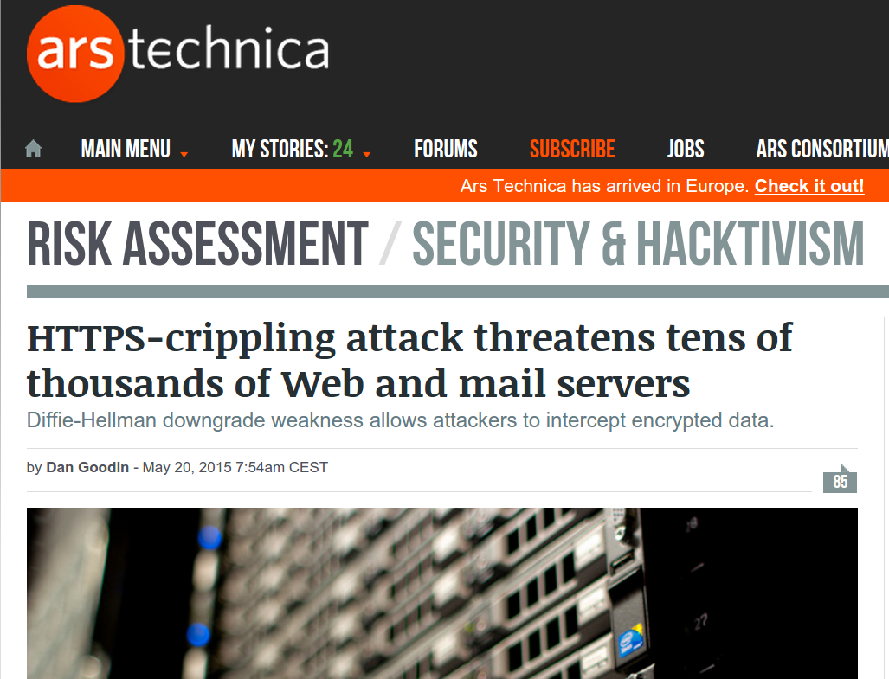
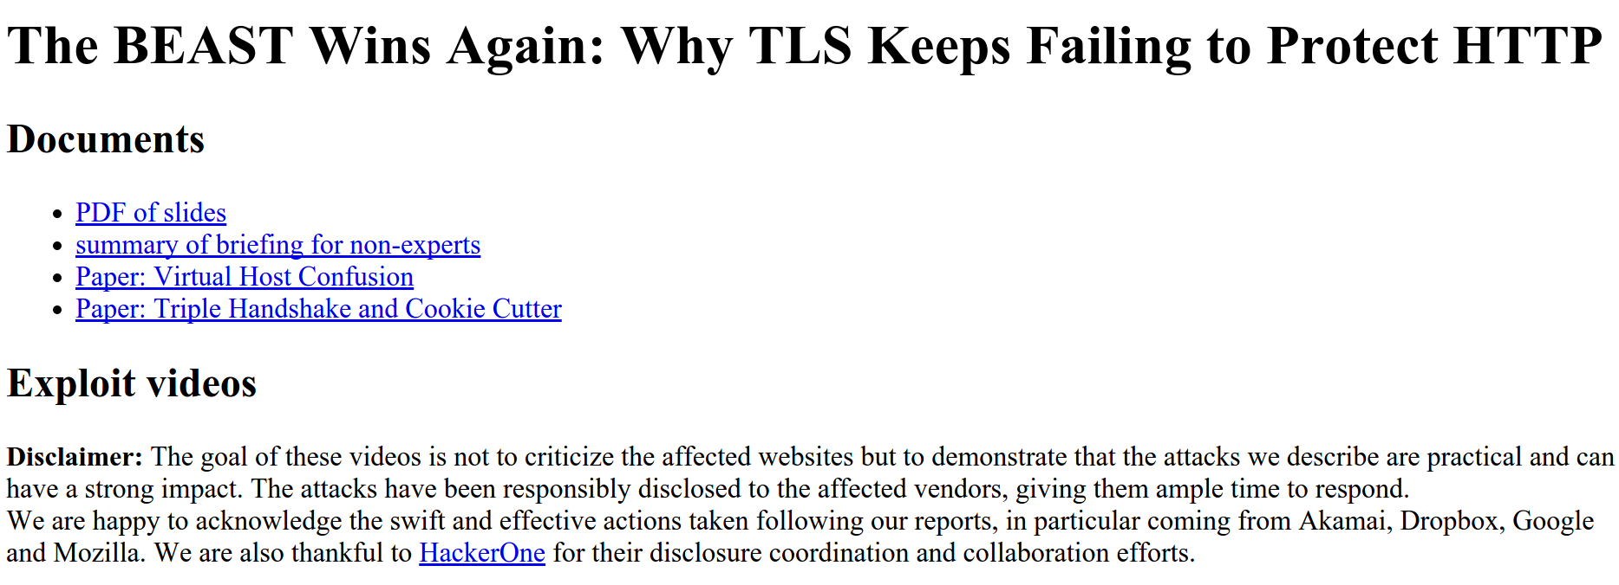
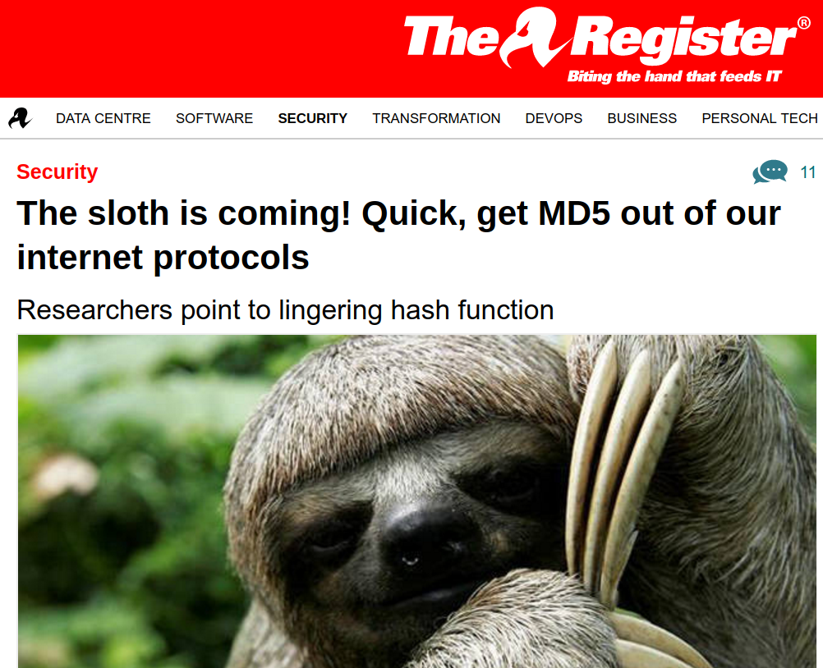
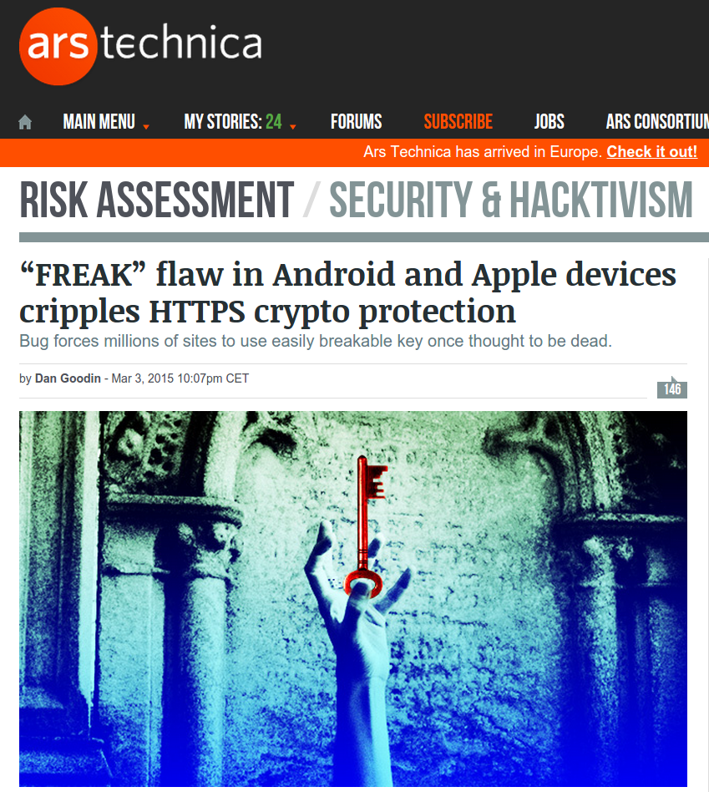
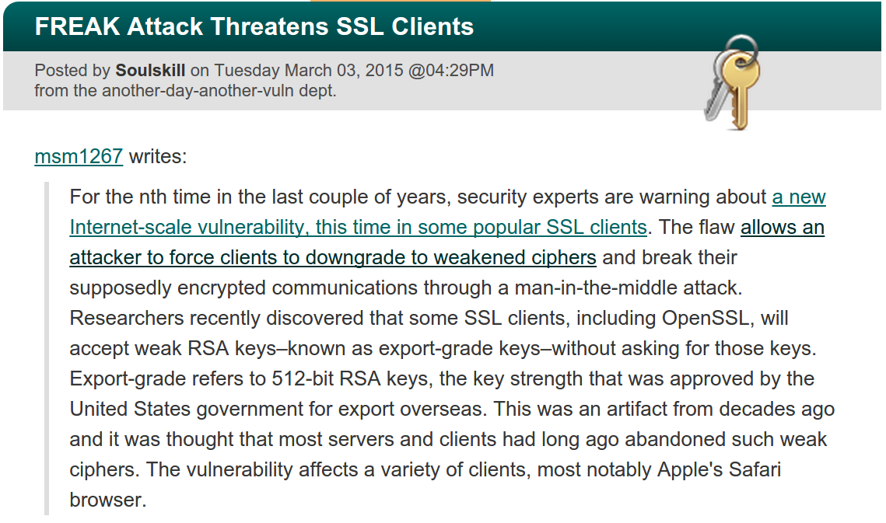
Finding attacks in TLS
Notes:
Bugs both in the protocol and it’s implementation

Slide 4
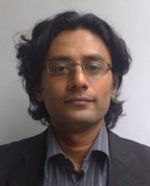

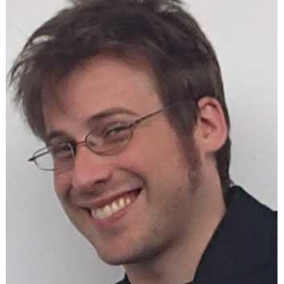

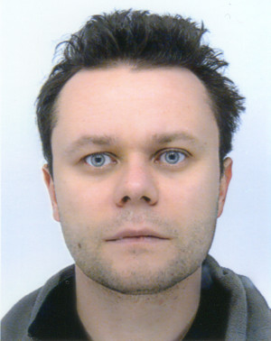
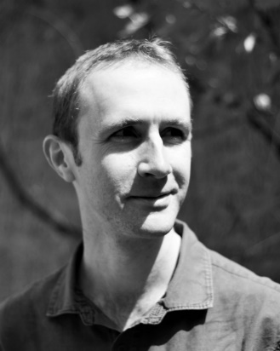
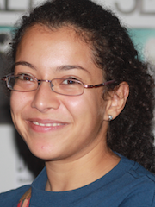

Researchers
Karthik Bhargavan
Bruno Blanchet
Harry Halpin
Cătălin Hrițcu
Graham Steel
Christine Rizkallah

Slide 5
Current team
Researchers (6)
Karthik Bhargavan
Bruno Blanchet
Harry Halpin
Cătălin Hriţcu
Graham Steel
Christine Rizkallah
PostDocs (2)
Danel Ahman
Marco Stronati
PhD Students (4)
Benjamin Beurdeuche
Nadim Kobeissi
Kenji Maillard
Jean Karim Zinzindohoue
Engineers (2)
Tomer Libal
Marc Sylvestre
Interns (4)
Victor Dumitrescu
Guglielmo Fachini
Natalia Kulatova
Théo Laurent
Visitors (3)
David Baelde (ENS Cachan)
Ana Nora Evans (Univ of Virginia)
David Evans (Univ of Virginia)
Diverse and international
11 nationalities
Our working language is English
Collaborators at Microsoft Research, UPenn, MIT, Northeastern, Portland State, IMDEA, Imperial, UCL, ...
Notes:
TODO: do a map, like Catiusha, both for our nationalities, trajectories and our collaborators

Slide 6
Use formal methods to achieve security of critical software
HTTPS stack (miTLS, Everest)
Modern cryptographic library (HACL*)
Secure messaging app (CryptoCat, NEXTLEAP)
Web browser core (CIRCUS)
Compilers & monitors (Micro-Policies, SECOMP)
TCP/IP network stack ...

Slide 7
Tools for analyzing abstract models of crypto protocols
ProVerif
symbolic model (Dolev-Yao)
fully automatic, efficient, precise, produces attack traces
wide range of crypto primitives and properties
CryptoVerif
computational model
semi-automatic: sequence of crypto games
exact security: bound on attack probability
Recent case studies: TLS 1.2 & 1.3, Signal, ARINC823
upcoming TLS 1.3: big redesign, new hope for verification

Slide 8
From verifying protocol models to actual implementations
Protocol models
capture core behavior: succinct, abstract, high-level
great for finding logical flaws [3Shake] and incorrect use of crypto [Lucky13] early in the protocol design phase
e.g. TLS 1.2 & 1.3 in ~1000 lines of ProVerif (best paper at Oakland'17)
Protocol implementations
large software projects: interoperable, efficient
concrete packet formats, multiple protocol modes
support legacy ciphersuites, complex APIs, composable subprotocols
more attacks: message parsing [HeartBleed], state machine [FREAK]

Slide 9
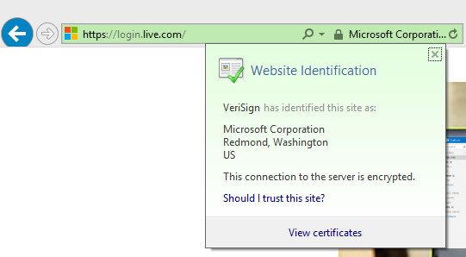
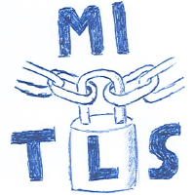
Verified reference implementation of TLS 1.2 & 1.3
Microsoft Research and Inria
Built on top of our HACL* crypto library
verified and faster than OpenSSL libcrypto and Sodium
Towards a verified HTTPS stack (Project Everest)

Slide 10
HTTPS ecosystem critical, complex
Services & Applications
Edge
cURL
WebKit
Skype
IIS
Apache
Nginx
Clients
Servers
HTTPS
Certification Authority
X.509
ASN.1
TLS
***
RSA
SHA
ECDH
4Q
Crypto Algorithms
Network buffers
Untrusted network (TCP, UDP, …)
Notes:
Distributed system, networking, cryptography.
Complex, but not necessarily large.
Smaller than a browser or an OS, for example.
Amenable to formal verification.

Slide 11



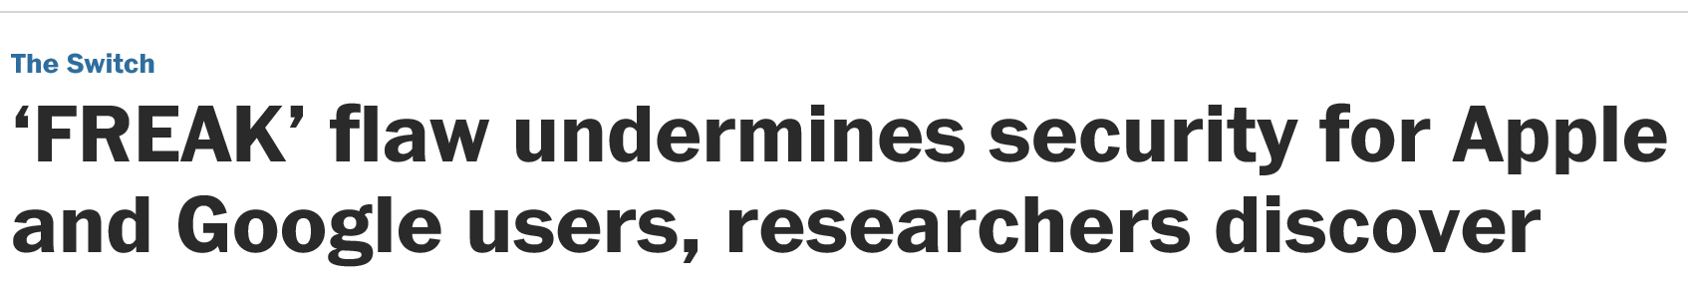
HTTPS ecosystem critical, complex
and broken
20 years of attacks & fixes Buffer overflows Incorrect state machines Lax certificate parsing Weak or poorly implemented crypto Side channels
Informal security goals Dangerous APIs Flawed standards
Mainstream implementations OpenSSL, SChannel, NSS, … Still patched every month!
Services & Applications
Edge
cURL
WebKit
Skype
IIS
Apache
Nginx
Clients
Servers
HTTPS
Certification Authority
X.509
ASN.1
TLS
***
RSA
SHA
ECDH
4Q
Crypto Algorithms
Network buffers
Untrusted network (TCP, UDP, …)
Notes:
Many attacks and fixes.
More fundamental problems.
For example, the security goals are informal, revised after some attacks.
The APIs are hard to use securely—many misconfigured clients and servers.
And we found flaws in the standards too, not just their implementations.

Slide 12
Project Everest Goals
Strong verified security
Widespread deployment
efficiency
interoperability
drop-in replacement for OpenSSL, NSS, ...
Services & Applications
Edge
cURL
WebKit
Skype
IIS
Apache
Nginx
Clients
Servers
HTTPS
Certification Authority
X.509
ASN.1
TLS
***
RSA
SHA
ECDH
4Q
Crypto Algorithms
Network buffers
Untrusted network (TCP, UDP, …)
Notes:
Fully-verified standards-compliant replacement
- We will prove cryptographic security, not just eliminate bugs.
- As a result, we rule out both past attacks, and attacks we haven’t even thought of yet
Many academically successful verification projects. Few deployments. Challenging research goal.

Slide 13

Everest stack verified with
Functional programming language
like OCaml, F#, Haskell, …
extracted to OCaml or F# by default
subset of F* compiled to efficient C code
Semi-automated verification using SMT
like Dafny, FramaC, Why3, …
Interactive verification using dependent types
like Coq, Lean, Agda, …

Slide 14

Is verified code secure in practice?
OK we can verify this
Unsafe languages
Ooops
Everest HTTPS
30.000 LOC
Web browser/server
2.000.000+ LOC
F*
C/C++
ASM
compiled F*
compiled C/C++
compiled ASM
Insecure interoperability
Notes:
end: We have 2 problems

Slide 15

Secure compilation
Secure interoperability with lower-level code
component separation, call and return discipline, types, ...
Dynamic enforcement, but at what cost?
in software, 10x? 100x? 1000x?
Micro-policies
new tagged hardware architecture
associates large metadata tag to each word
efficiently propagates and checks tags; hw caching
dynamic monitoring: software defined, very flexible, fine-grained (words, instructions), fast …
… average 10% runtime overhead for complex policies!

Slide 16
Use formal methods to achieve security of critical software
HTTPS stack (miTLS, Everest)
Modern cryptographic library (HACL*)
Secure messaging app (CryptoCat, NEXTLEAP)
Web browser/server core (CIRCUS)
Compilers & monitors (Micro-Policies, SECOMP)
TCP/IP network stack ...

